Slide 1
Improving the Bottom Line by Optimizing Patient Throughput
Panelist: Titi Britto, MD, MBA, MAS
Terry Schwartz
Moderator: Tulay Aksoy, MD, SFHM, FACP

Slide 2
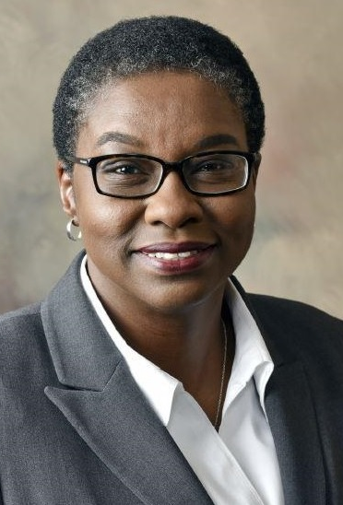
Panelists
Dr. Britto, is a board-certified internist and serves as Vice-President of Hospital-Based Specialties for Advocate Aurora Health Medical Group, where she is responsible for growth, strategy, and continuous improvement in clinical quality, operational effectiveness and physician and APC engagement in the departments of Anesthesia, Critical care, Emergency Medicine, Hospital Medicine and Imaging. She joined AAH in Oct 2016, as President of Hospital medicine, leading Hospital medicine clinicians in 15 Wisconsin Hospitals.
Prior roles include Chief Medical Officer, Medical Director of Hospital Medicine Chief of Medicine at Cartersville Medical Center, Cartersville, GA. She has practiced as a hospitalist since 2009, and previously practiced Nephrology from 1998-2009, and was Chair for the Department of Medicine at Phoebe Putney hospital and Medical Director for multiple Dialysis clinics in Albany, GA.
Prior to that she was an internist and Associate Medical Director at Geneva B. Scruggs community Health Care center, a federally qualified health care center in Buffalo, New York with a teaching appointment at the university of Buffalo Medical School.
Dr. Britto obtained her medical degree from the College of Medicine, University of Ibadan in Nigeria. She received her master’s degree in Business Administration from The George Washington University in Washington DC and holds a Master of Applied Science in Population Health Management from the Johns Hopkins University in Baltimore, Maryland. She completed her Residency in Internal Medicine and her Fellowship in Nephrology at the University of Illinois at Chicago hospital in Chicago Illinois,
Dr. Britto is an active member of several professional organizations including the American College of Healthcare Executives and is a Fellow of the American College of Physicians. She has served on the Hospital Quality and Patient Safety Committee of the Society of Hospital Medicine and is a Senior Fellow of the Society of Hospital Medicine. Throughout her professional career Dr. Britto has championed, led and executed many quality, patient safety and efficiency initiatives which resulted in improved performance and outcomes. She was recognized with the 2013 Physician Frist Humanitarian Award at Cartersville medical center. Dr. Britto is passionate about improving quality in healthcare, effective communications and increasing safety in transitions between healthcare settings for all patients and especially for hospitalized vulnerable patients.
Titilola Britto, MD, MBA, MAS
Vice President, Hospital-Based Specialties Clinical Program, Advocate Health-Midwest Region

Slide 3
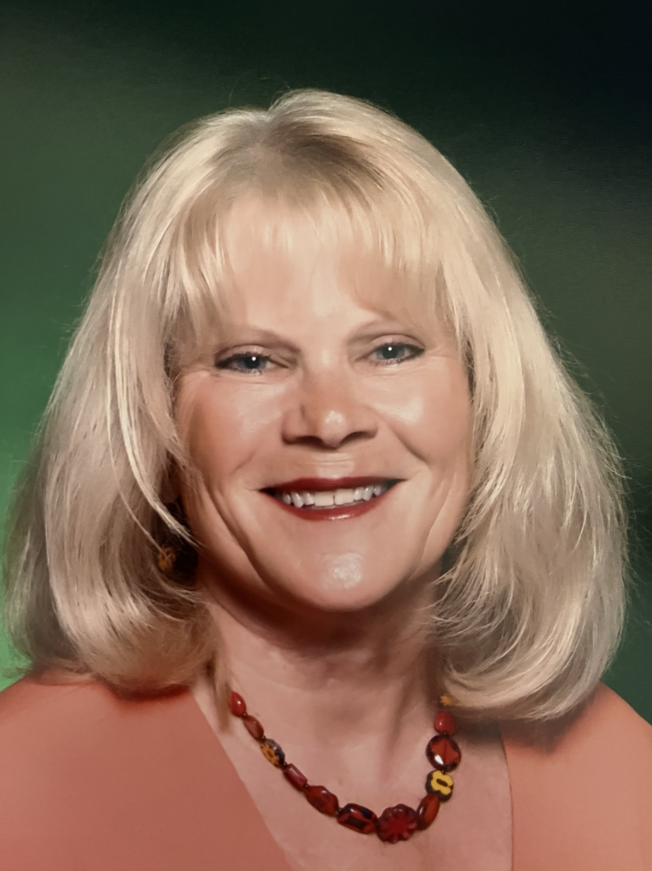
Panelists
Terry is a seasoned healthcare administrative leader with extensive experience in developing successful service lines, notably in Pediatric Orthopedics. She began her career in frontline clinical work, specializing in Nuclear Medicine at Children’s Wisconsin, before transitioning into leadership roles. Terry first led special imaging departments, focusing on staffing, access, and process improvement, and later expanded her leadership to oversee the Orthopedic Clinic, where she tackled issues of access, workflow inefficiencies, and patient satisfaction.
Her involvement in a 2-year IHI Improvement Project, led by Don Berwick, ignited her passion for patient-centered improvement work. Terry became instrumental in transforming clinic operations using Lean principles, driving significant growth in patient volume and geographic expansion of services. Under her leadership, the Pediatric Orthopedic service line grew from 13,000 to 39,000 visits annually, increased faculty from 5 to 28, and strategically expanded to multiple locations across Wisconsin.
Terry is proud of transforming access to fracture care, enabling same-day appointments, and fostering a culture of operational efficiency and patient-centered care. Her leadership drives high patient satisfaction and operational excellence across the service line.
Terry Schwartz
Advisor at FlowOne Lean Consulting, LLC

Slide 4
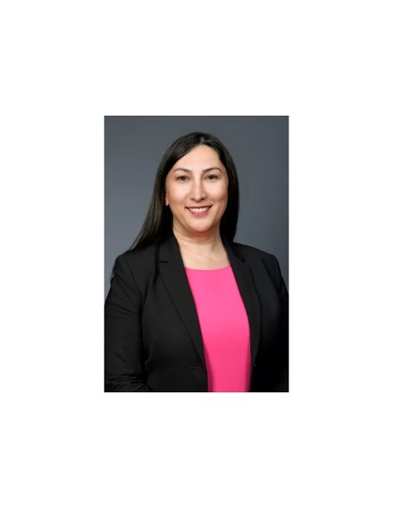
Moderator
Dr. Tulay Aksoy is the Chief Medical Officer at Aurora Sinai Medical Center and Aurora St. Luke’s South Shore Hospital, overseeing over 1,700 physicians. She is a board-certified Internal Medicine physician and is currently pursuing an Executive MBA at the Kellogg School of Management, Northwestern University, with a focus on healthcare leadership. Dr. Aksoy was recently honored as one of the Top 50 Women in Medicine by Women We Admire in 2024, recognizing her exceptional leadership and contributions to healthcare. With extensive experience in healthcare leadership, she has successfully led multiple initiatives to improve patient throughput, reduce length of stay, and enhance quality of care. She has also been instrumental in performance improvement projects, resulting in significant clinical and financial outcomes. Dr. Aksoy is an active member of the Milwaukee Health Care Partnership and has developed numerous programs to improve patient care and outcomes​
Tulay Aksoy, MD, SFHM, FACP
Chief Medical Officer
Aurora Sinai Medical Center
Aurora St. Luke’s South Shore Hospitals

Slide 5
Learning Objectives
Identify key strategies to optimize patient throughput for improved operational efficiency
Implement methods to expedite discharges by leveraging hospitalists
Explore approaches to restructure care management and reduce patient length of stay
Quantify and track financial and quality benefits resulting from throughput improvements

Slide 6
Poll Question
What is your level of leadership experience in driving patient care optimization initiatives?
I have led multiple optimization initiatives in my organization
I have been involved in a leadership capacity in one or two initiatives
I have contributed as part of a team but not in a leadership role
I am new to this area and looking to gain leadership experience

Slide 7
Preamble
US cost of care compared with OECD countries %of US GDP being spent on health care Quality lags behind Access lags behind IHI Quadruple aim Expenses and supply chain up, and reimbursement down Many healthcare systems with financial challenges- both rural and urban closures Must reduce the cost of care and improve the bottom line to maintain access Reducing LOS with throughput optimization is one strategy in a complex health ecosystem

Slide 8
Dollars (USD) per capita spend on health expenditures
The U.S. spends three to four times more on health care than South Korea, New Zealand, and Japan.
The U.S. is the only high-income country that does not guarantee health coverage.
U.S. life expectancy at birth is three years lower than the OECD average.
Data: OECD Health Statistics 2022.
Source: Munira Z. Gunja, Evan D. Gumas, and Reginald D. Williams II, U.S. Health Care from a Global Perspective, 2022: Accelerating Spending, Worsening Outcomes (Commonwealth Fund, Jan. 2023). https://doi.org/10.26099/8ejy-yc74

Slide 9
Health spending share of GDP will rise to 19.7% by 2032 from 17.3% in 2022.
Healthcare spending in the U.S. $4.8 trillion in 2023
Spending on Medicaid and private health insurance drove the growth,.
estimated healthcare spending per person in the U.S. stood at about $14,423 in 2023 and $15,074 in 2024.
Spending is set to grow an average of 5.6% a year between 2023 and 2032, outpacing the projected annual gross domestic product growth rate of 4.3% during the same period.
Fiore, J., Madison, A., Poisal, J., Cuckler, G., et al. (2024) Health Affairs ( 43:7 ) National Health Expenditure Projections, 2023–32: Payer Trends Diverge As Pandemic-Related Policies Fade. Retrieved September 20, 2024 from https://www.healthaffairs.org/doi/10.1377/hlthaff.2024.00469

Slide 10
US Life Expectancy lags Behind

Slide 11
"The top-performing countries overall are Norway, the Netherlands, and Australia. The United States ranks last despite spending far more of its gross domestic product on health care”. (Commonwealth fund)

Slide 12
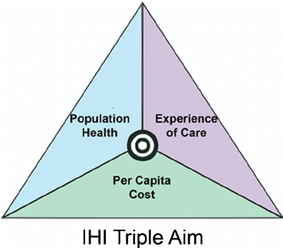
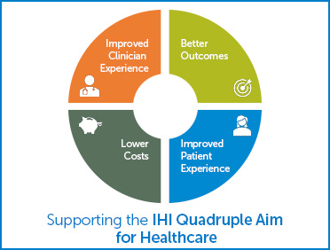
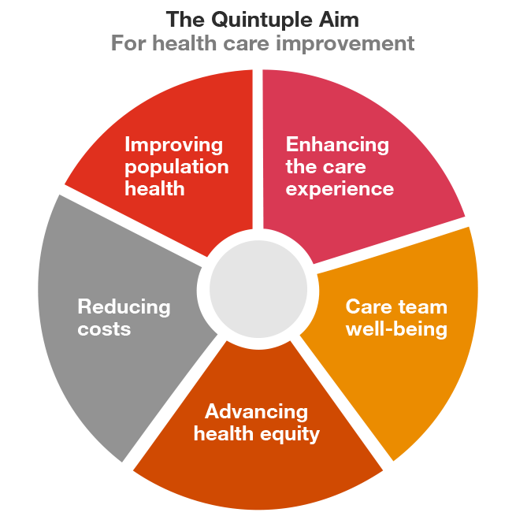
Moving from the triple aim to the quadruple to the Quintuple Aim
2008
2014
2024

Slide 13
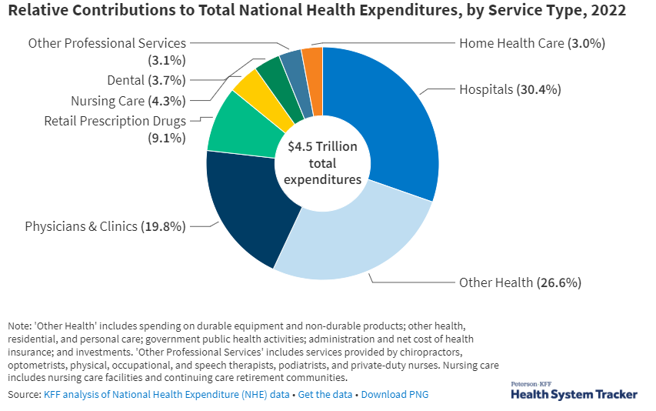

Slide 14
3. Upfront costs for critical equipment and device upgrades are high. For example, magnetic resonance imaging machines are, on average, $3.2 million.
4. Since 2022, the number of days cash on hand has fallen by 28.3% for hospitals and health systems.
5. The average age of capital investments for medical equipment and infrastructure rose 7.1% for all hospitals in 2023, meaning these businesses are conducting tradeoffs to maintain healthcare services and postponing planned upgrades.
6. In 2022, Medicare paid 82 cents for every dollar spent by hospitals, leading to a deficit of nearly $100 billion.
7. Denials cost hospitals $20 billion every year, and denials for commercial Medicare Advantage plans increased 55.7% in 2023. Health insurance premiums grew at a rate of 6.7% while hospital prices increased 2.6%.
8. In 2022, hospitals spent nearly $30 billion on property and medical liability insurance.
9. The median annual list price for a new drug in 2023 was $300,000 — a 35% increase from 2022.
10. Labor costs in hospitals were $839 billion between 2021 and 2023, equal to nearly 60% of the average hospital's expenses. In 2023, the advertised wage rates for all hospital jobs increased 10.1%.
Medical supplies cost hospitals $146.9 billion in 2023 — an uptick from about $140 billion expenses a year prior, the American Hospital Association said in a May update of its Costs of Caring report.
Leaders at hospitals and health systems should expect to continue seeing price increases for labor, drugs and medical supplies in 2024, the AHA said.
Here are 10 things supply chain executives should know:
1. In 2023, medical supply costs accounted for about 10.5% of the average hospital's budget.
2. Inflation increased 12.4% between 2021 and 2023 — a rate that is more than two times faster than Medicare reimbursement for inpatient care.

Slide 15
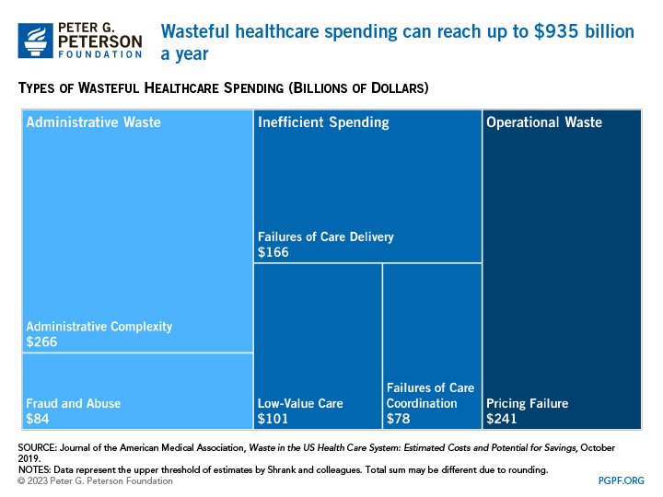

Slide 16
Summary
US Health care costs are higher than other nations and continue to rise
US healthcare is costly and inefficient and outcomes are not optimal
We Must all focus on the quintuple aim
Understand and identify drivers of rising cost, identify and eliminate waste
Excess LOS is a form of waste with elements of “failure of care coordination”, “administrative complexity” and “operational waste”
Reducing LOS reduces cost of care and improves outcomes

Slide 17
Advantages of Reduced LOS
Hospital inpatient care
30% of healthcare expenditures in the U.S
Average LOS is 4.5 days
average cost of $10,400 per day.¹
Optimizing and reducing LOS improves
financial, economic
operational,
clinical outcomes ²
REFERENCES
Agency for Healthcare Research and Quality. (2014). Overview of hospital stays in the United States, 2012.
Jennings, N. (2015). Inpatient care – Calculating the cost of length of stay. Hospitals & Health Networks.

Slide 18
Key Take Aways
Optimize Patient Flow: Effective throughput strategies reduce costs, increase capacity, and improve patient experience
Interdisciplinary Collaboration: Success depends on teamwork across clinical and administrative areas
Data-Driven Decisions: Use metrics like length of stay and readmission rates to guide improvements
Maximize Capacity Without Adding Beds: Streamlining discharge and care management creates space and enhances access
Measurable Outcomes: Improved patient outcomes, satisfaction, and financial performance are achievable

Slide 19
Questions? Thank you!

