Slide 1
Sustainable Strategies to Support Well-being for Healthcare Professionals

Slide 2
Faculty
Mallory Salentine, MD, ACC, TIPC, FAAP
  Medical Director, Provider Well-Being, Children’s Wisconsin Primary Care, Associate Medical Director, Provider Well-Being, Pediatrician, Children’s Wisconsin
Alicia Pilarski, DO
  Chief Well-Being Officer, Professor of Emergency Medicine, Froedtert and Medical College of Wisconsin
Gavin Quinnies
  CEO, US HealthCenter, Inc.

Slide 3
Agenda
Background on well-being and burnout
Panelist Questions
Interactive Audience Questions
Q+A

Slide 4
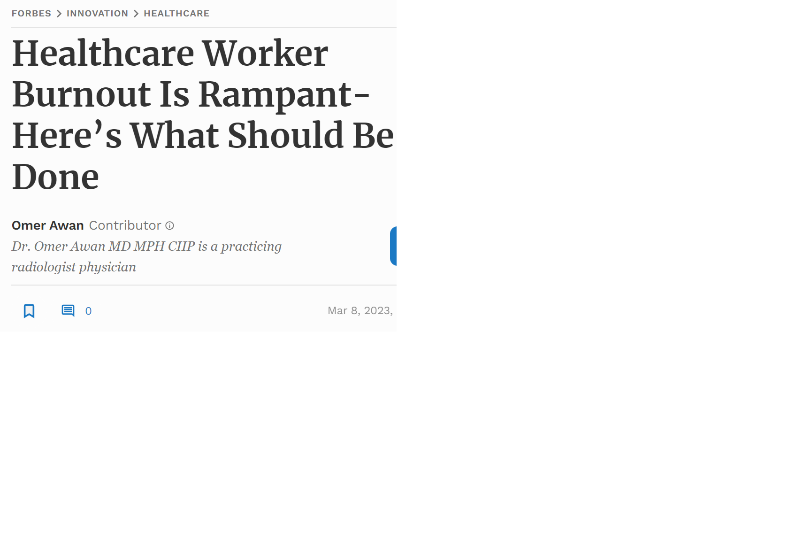
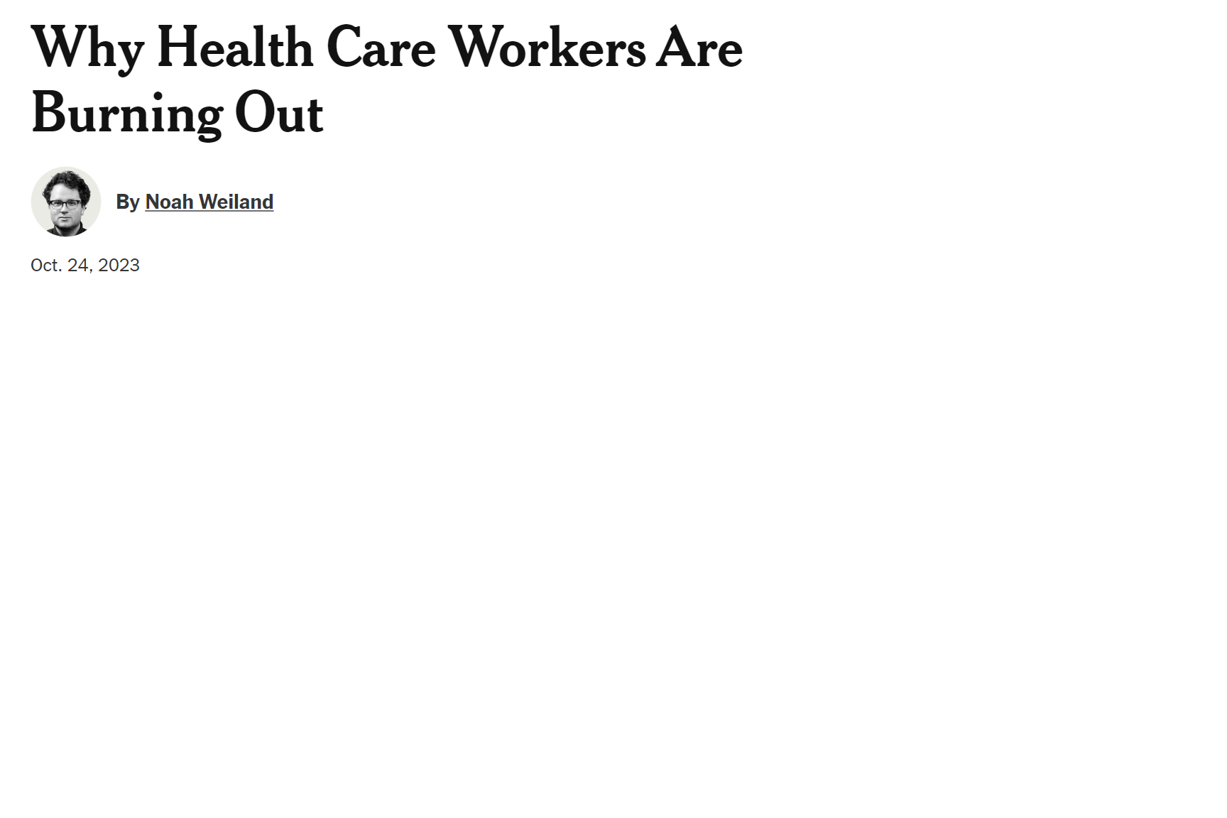
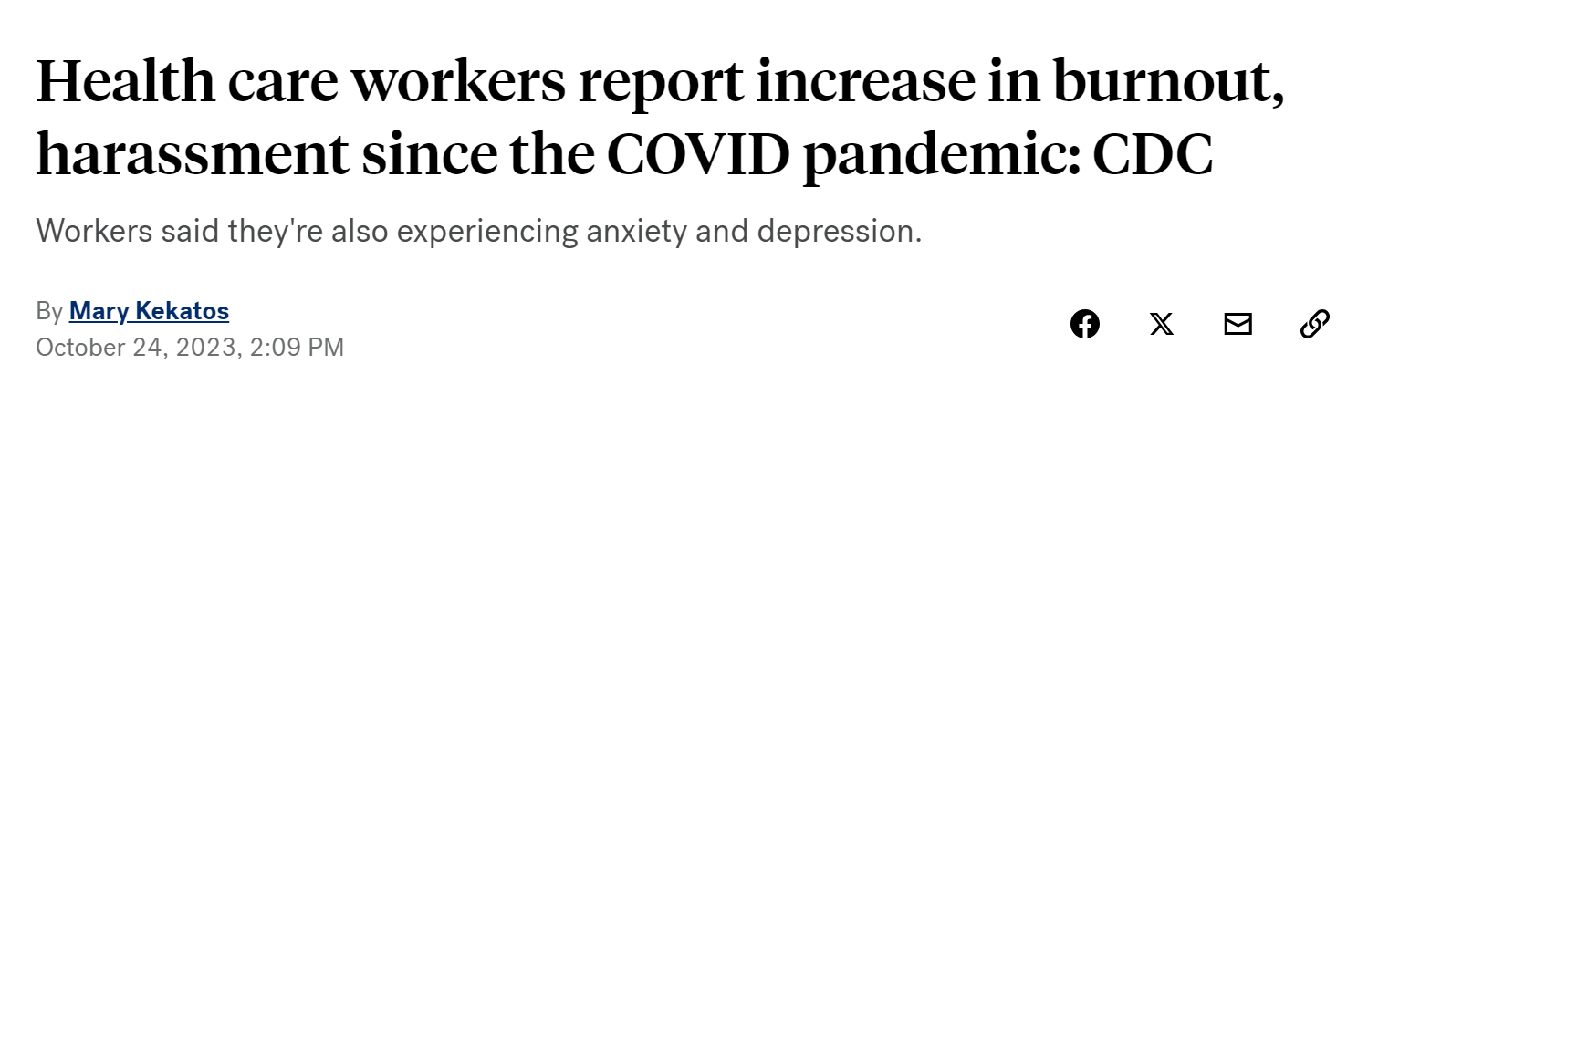
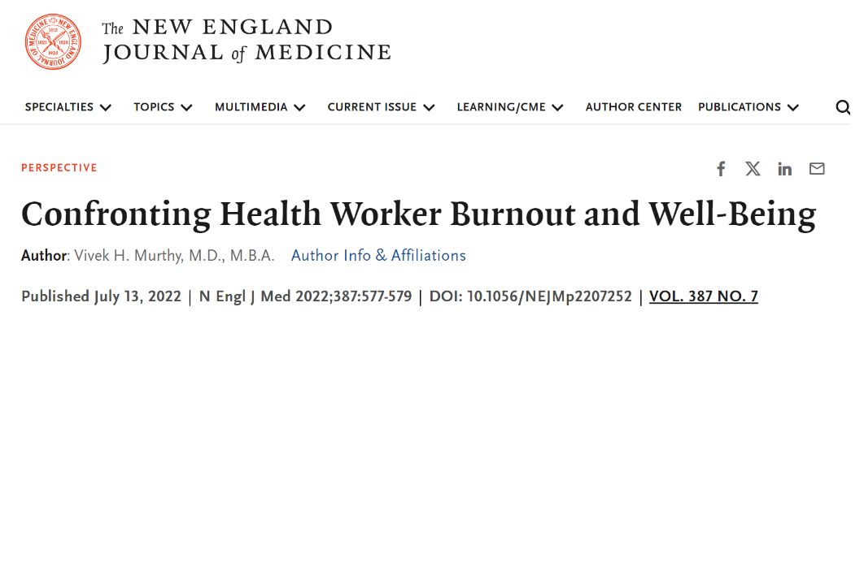
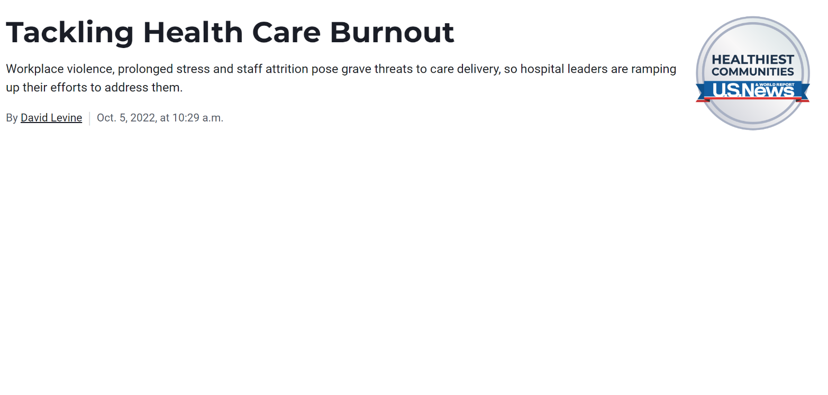
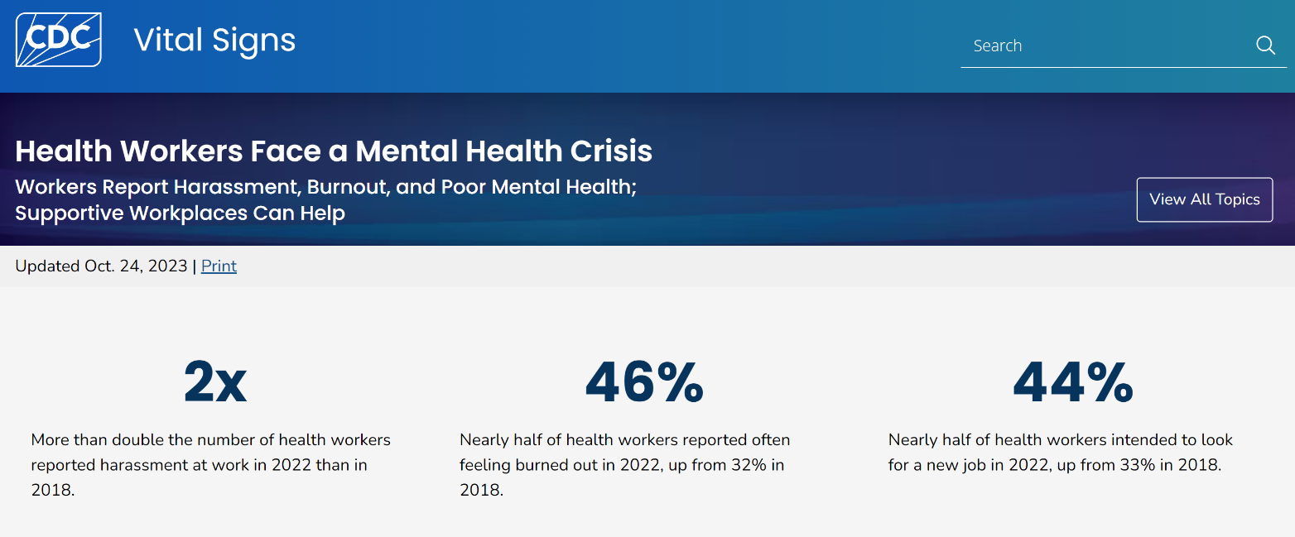
Notes:
Burnout is increasing in healthcare, accelerated after the pandemic (higher than the other US workers). This has significant impact on the ability to provide safe, high quality care to our patients, leads to increased cost of care, increased health care disparities, and ultimately has significant negative impact for the individual caregiver. Suicide rates are significantly higher in health care workers compared to non-health care workers and the epidemic of loneliness (as described by our Surgeon General, Dr. Vivek H. Murthy) is a growing concern for healthcare workers in the last few years.
“Burn-out is a syndrome conceptualized as resulting from chronic workplace stress that has not been successfully managed. It is characterized by three dimensions:
feelings of energy depletion or exhaustion;
increased mental distance from one’s job, or feelings of negativism or cynicism related to one's job; and
reduced professional efficacy.
Burn-out refers specifically to phenomena in the occupational context and should not be applied to describe experiences in other areas of life.”

Slide 5
Impact to healthcare workers and patients

Slide 6

Wellness vs
Well-Being
Cummings, K. The Science What’s the Difference Between Wellness and Well-Being? Wellbeing Wisdom.
https://www.wellbeingwisdom.net/perspectives/wellness-vs-wellbeing?rq=well%20being
Notes:
Wellness is integrating physical, mental, emotional, spiritual, financial health. More about the individual.
Well-Being is about the environment that you are in and the purpose, meaning, and mattering that you experience in that environment. Well-being is affected by the way the work happens and the sense of joy and fulfillment that people derive from their work experience. Wellness if often part of a company’s benefits program whereas well-being is about culture, workplace efficiencies, communication, and meaning in work.

Slide 7
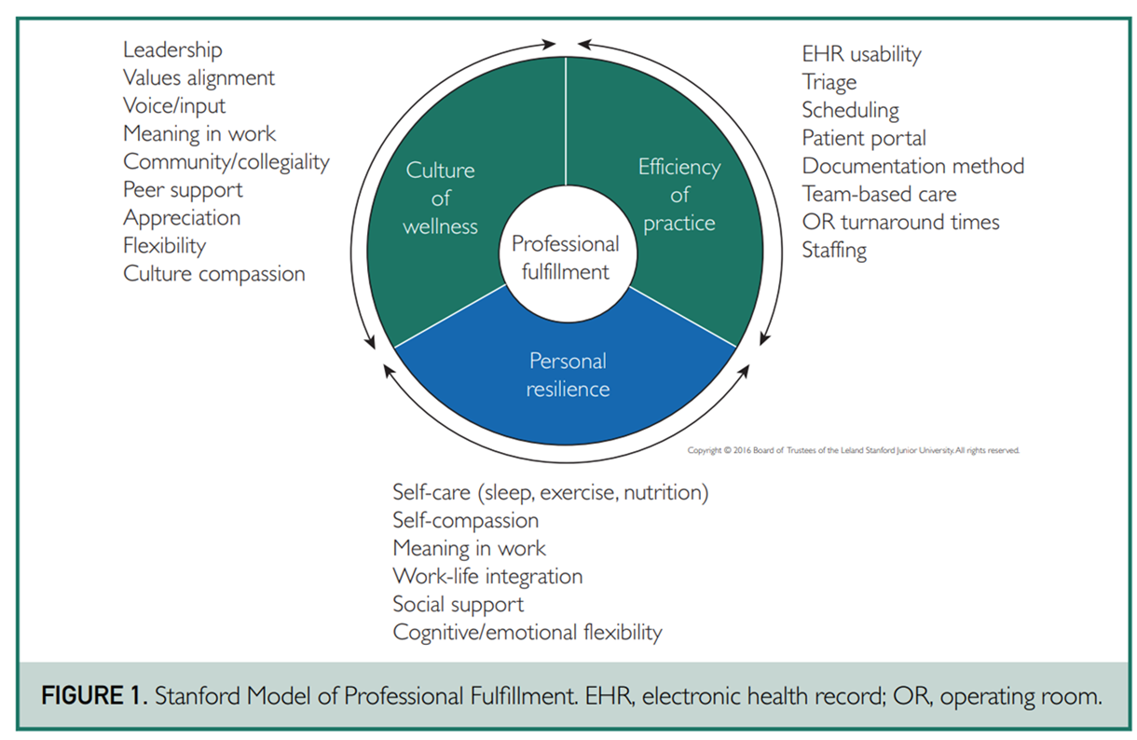
Stanford Model of Professional Fulfillment
Organization-Wide Approaches to Foster Effective Unit-Level Efforts to Improve Clinician Well-Being. Shanafelt, Tait D. et al. Mayo Clinic Proceedings, Volume 98, Issue 1, 163 - 180

Slide 8
American Medical Association (AMA) Joy in Medicine Recognition
Assessment
Commitment
Efficiency of practice environment
Teamwork
Leadership
Support
AMA Joy in Medicine Health System Recognition Program. Updated September 5, 2024.
Accessed September 23, 2024.
https://www.ama-assn.org/practice-management/physician-health/ama-joy-medicine-health-system-recognition-program

Slide 9
National Academy of Medicine (NAM) Plan for “Taking Action Against Clinician Burnout” 7 priorities:
Create and sustain positive work and learning environments and culture
Invest in measurement, assessment, strategies, and research
Support mental health and reduce stigma
Address compliance, regulatory, and policy barriers for daily work
Engage effective technology tools
Institutionalize well-being as a long-term value
Recruit and retain a diverse and inclusive health workforce
National Academies of Sciences, Engineering, and Medicine. 2019. Taking Action Against Clinician Burnout: A Systems Approach to Professional Well-Being.
Washington, DC: The National Academies Press. https://doi.org/10.17226/25521.

Slide 10
Session Materials
Dunn, J. (Fall 2021). A Deep-Rooted Culture Evolves to Support Healthcare Heroes. Frontiers of Health Services Management. 38(1):14-19.
Finkel, E. (Nov/Dec 2022). Strategies for Developing Stronger, Healthier Teams. Healthcare Executive.
Meese, K.A., Colon-Lopez, A., Singh, J.A., Burkholder, G.A., Rogers, D.A. (July-August 2021). Healthcare is a Team Sport: Stress, Resilience, and Correlates of Well-Being Among Health System Employees in a Crisis. Journal of Healthcare Management. 66(4):304-322.
Piche, M.E. & Weinberg, C. (July/August 2023). Mindfulness Meditation for Veterans and Staff. Healthcare Executive.
Shanafelt, T., Trockel, M., Wang, H., Mayer, T., Athey, L. (September-October 2022). Assessing Professional Fulfillment and Burnout Among CEOs and Other Healthcare Administrative Leaders in the United States. Journal of Healthcare Management. 67 (5).

Slide 11
Additional Resources
https://www.ache.org/blog/2022/a-path-forward-addressing-clinician-burnout-through-systems-level-change
https://www.ache.org/learning-center/publications/books/2477I
https://www.ache.org/learning-center/research/about-the-field/top-issues-confronting-hospitals/top-issues-confronting-hospitals-in-2022
https://www.aha.org/aha-center-health-innovation-market-scan/2022-12-20-executive-burnout-real-and-it-can-be-reduced
https://www.aha.org/aha-center-health-innovation-market-scan/2022-12-20-executive-burnout-real-and-it-can-be-reduced

Slide 12
Thank You

