Slide 1
Embracing the Digital Shift: AI’s Role in Transforming Healthcare
ACHE-WI Annual Conference
September 24, 2024
Chris Tommaso, M.S., FACHE

Slide 2
What does the future look like?
Notes:
You can get a good idea of where the future of AI and healthcare are going just by looking at your smartwatch.
How many people have a smartwatch?
So much data on these devices – heart rate, motion, ECG, temperature, blood oxygen, elevation.
Mayo is currently engaged in a study (REGAL) to test whether Apple Watch, used as a long-term monitoring device, can enable early diagnosis of AF? AI tools developed at Mayo can identify ECGs (that have a normal sinus rhythm) that indicate significant risk for AF.
Personal experience – Have you ever woken up in the morning not felling well? Didn’t sleep well, feel kinda hot or low energy, not sure if you should go to work that day. For some people that may just be called Monday morning, but I woke up felling like that a couple months ago. Since I wear a smart watch to sleep, I was able to check my sleep data and see that my wrist temperature overnight was significantly elevated. I was running a fever and shouldn’t go into work.
This is the tip of the iceberg when you think of continuous monitoring and real time alerts and interventions.

Slide 3
What many people think
Notes:
It may be easy to think:
-hard part is done, we have the technology and tool to implement AI to solve all our problems
-AI can detect disease, serve as chat bots, notify my staff when they miss something

Slide 4
Reality:
Notes:
Reality is that we have only just found the mountain. Advancements in technology have only made training models relatively easy. Still many challenges in every step of the AI journey.

Slide 5
Current State
Notes:
In the current state healthcare is driven by teams of people. Our tools and technology is changing, but this is a team sport that still requires face to face interactions with patients and colleagues.

Slide 6
Adding Value
Helping us perform tasks
Doing tasks we don’t want to do
Doing tasks we cannot do

Slide 7
Developing a Strategy for AI
Notes:
Data and privacy
Computational resources
Human resources
External collaborations

Slide 8
Data and Privacy
What is the current state of your data?
What do you want to do with your data?
Notes:
Data is the foundation for any AI model. It needs to be clean and it needs to be accessible.

Slide 9
Current and Past
Notes:
Hospital systems are siloed and have their data behind walls. Maybe a few small gates for some data to go in or out. But very isolated and remote. It feels very secure. We care about our patients, we care about our reputation. We do not want hackers stealing patient data or locking up our systems.
But this also creates isolation. There are consequences to keeping our data this way. How can we make models that work well for everyone if we only training it on people within the walls? Mathematical models are designed to minimize error. We scrutinize AUC. What is the false positive rate, what is the sensitivity?

Slide 10
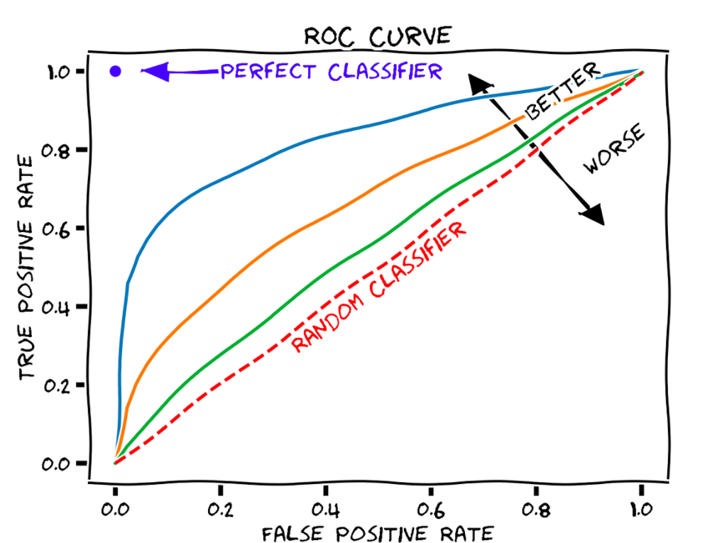
Image credit: Wikimedia
Notes:
Explain ROC. – Soft poll
Most models that are binary classifiers can be adjusted based on the specific situation. Do we want the model to be very sensitive – pick up every instance? Or do we want the model to be more specific – minimize false positives.
Walk through example of patient deterioration.
Want to pick up all patients that might be about to deteriorate
But don’t want clinical staff responding to false alarms and losing trust in the tool – cry wolf
Bring back to diversity
Model was trained to move the line further to the upper left – minimize errors.
If 80% of training set are white patients – very important to minimize errors from that section of the data. Increased error from other 20% will still give you a better overall model. But better for who?

Slide 11
Reality
Notes:
The reality is that our castles of data are not as secure or permanent as we would like them to be.
The future is trending to putting data into secure cloud environments.
Hospital systems are also looking for ways to share data while maintaining security and privacy.
Mayo Clinic Platform

Slide 12
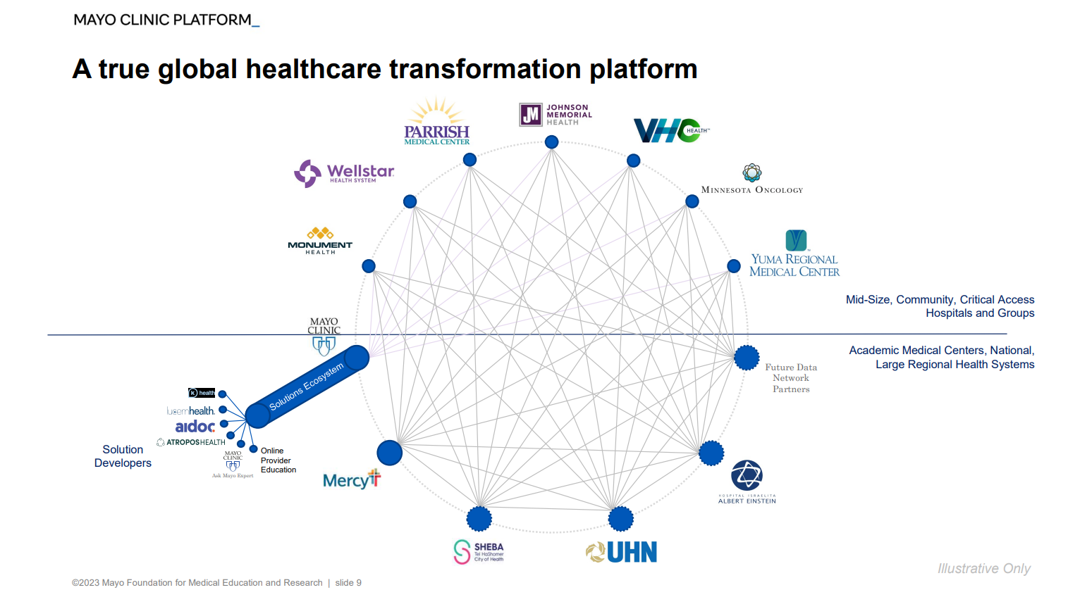

Slide 13
Computational Resources
On prem
Cloud
Notes:
On Prem
Entry level, capable systems can be relatively easy to get and set up.
Data pipelines can often be easier to set up
Higher level compute resources can quickly become capital intensive
Cloud
No capital, but expenses can quickly add up.
Need capabilities to build data pipelines
Need close monitoring to ensure jobs are turned off

Slide 14
Human Resources
Centralized vs. distributed vs mixed
Technical team
Clinicians
Administrative leadership
Implementation and evaluation
Notes:
Centralized vs. distributed vs mixed
Technical team
Maintenance plan
Clinicians
Administrative leadership
Implementation and evaluation
Mayo Clinic has a mixed model:
Distributed resources with Cardiology, Radiology have had teams operating for years. Neurology hired first Data Scientist back in 2019. More departments expanding their capabilities. Some building off grant funded work, increasingly looking for practice funded resources.
Centralized enablement resources with Center for Digital Health and Mayo Clinic Cloud. Works closely with IT to enable the infrastructure. Data pipelines, data engineering, integration into the EHR.
Centralized resource in the Kern Center for the Science of Health Care Delivery

Slide 15
Healthcare Leader’s Role
Development
Validation
Implementation
Maintenance

Slide 16
Questions

Slide 17
Learning Objectives
Identify current applications of AI in healthcare, such as diagnostic tools, treatment planning, patient engagement, and administrative tasks.
Explore future developments in AI and their implications for healthcare delivery.
Explore the ethical implications of AI in healthcare, including privacy concerns, data security, and the potential for bias.
Identify strategies for integrating AI into healthcare settings.

Slide 18
Introduction

